Slide 1
Mountain View Fire Community Workshop Insurance & Recovery Guidance
Valerie Brown, Senior Program Officer
Valerie@uphelp.org
January 11, 2021

Slide 2
About United Policyholders (UP)
Helping disaster survivors and advocating for consumers since 1991
Not for profit, not for sale
Funded by donations and grants
Trusted and respected nation wide

Slide 3
Our Three Programs
Roadmap to RecoveryTM
Guidance on maximizing insurance funds, making decisions and getting back home after a catastrophic loss
Roadmap to Preparedness
Helping households and communities reduce risk and be resilient to disasters and adversity
Advocacy and Action
Fighting for insurance consumer rights and protections
Notes:
AB

Slide 4
Team UP
Professional staff
Government and nonprofit partners
Volunteers
Fired UP Survivors - previous catastrophic loss survivors paying it forward
Consumer-oriented professionals
Damage and repair/rebuild cost estimators
Lawyers
Public Adjusters
Tax and Financial Planning experts
Construction and Real Estate professionals
Notes:
Val

Slide 5
R2R Guidance and Tools
“The Little Yellow Book”
Email info@uphelp.org to have a copy mailed to you
Notes:
ER

Slide 6
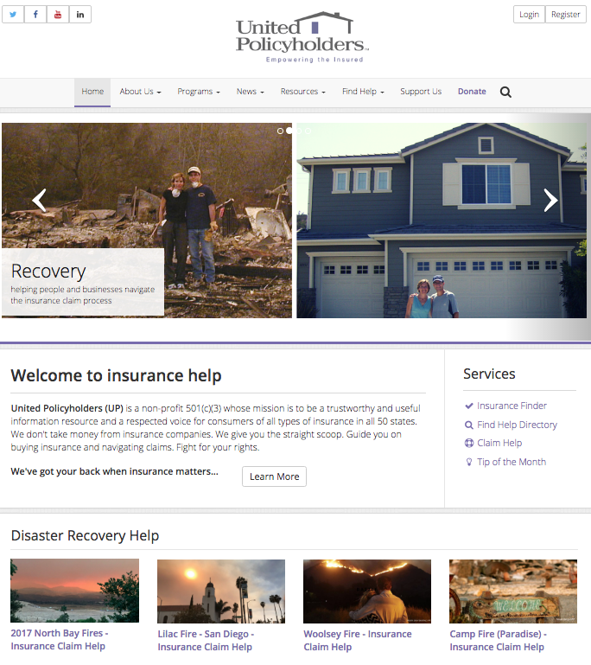
24/7 Help on the Web: www.uphelp.org/2020Wildfires
Claim Help for Disaster Survivors www.uphelp.org/2020Wildfires
Links to pro-consumer Professional help: www.uphelp.org/findhelp
Sample Letters & Claim Forms
www.uphelp.org/samples
“Survivor’s Speak” Tips from past disasters www.uphelp.org/SurvivorsSpeak
Upcoming workshops and resources www.uphelp.org/2020wildfires
Notes:
AB

Slide 7
Recovering from a Disaster is a Marathon, not a Sprint
Notes:
ER

Slide 8
Knowledge Equals Power AND...
The more you understand about your insurance benefits, your rights and the value of your losses, the more benefits you will recover to rebuild your home and life and the smoother your claim will go…
Notes:
ER

Slide 9
Ads are ads: Think of Your Insurance Claim as a Business Transaction
The insurance company wants to MINIMIZE $ it pays out on your claim.
You want to MAXIMIZE $ paid out to you.
An adjuster may be friendly but they’re not your friend – they’re a trained negotiator.
Notes:
AB

Slide 10
Getting on the road to recovery
Notes:
AB

Slide 11
Give your insurance company a chance to do the right hing, BUT, Don’t Be a Pushover
Notes:
AB

Slide 12
Should I Expect a “Fight” with my Insurance Company?
NO. Some claims go smoothly from beginning to end. We hope yours does.
But when large dollars are at stake, disputes often arise.
Getting informed about commonly disputed items will help you avoid problems.
Notes:
SW

Slide 13
Pace yourself, don’t rush
This is hard advice to follow because you want to get home as quickly as you can.
People who rush into major financial decisions can make costly mistakes
Losing a home is incredibly disorienting. Sleep deprivation and stress impede decision-making
It takes months for most people to regain their normal memory and critical thinking function.
Notes:
AB

Slide 14
Before you sign on the dotted line…
If your insurer asks you to sign a proof of claim form before you know how much you really have lost, write in “undetermined” under the amount of the loss.
Avoid signing contracts with vendors, professionals, etc. before vetting/researching
Notes:
AB

Slide 15
Removing debris
Removal can be done individually or through a coordinated process
Photograph debris before it gets taken away
Save the photos where you’ll be able to find them later
Notes:
SW

Slide 16
Work with a Complete and Current Copy of Your Home Insurance Policy
You need the “Declarations Page” and the entire contract, including ALL:
Endorsements
Riders
Request a Certified copy to be sure it’s the right one
Make a working copy that you can write notes and questions on.
Notes:
SW

Slide 17
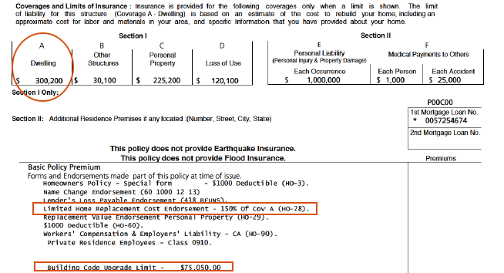
Dec page ABC’s
Notes:
SW

Slide 18
Speak “UP”
Present your requests clearly and in writing
Explain what you need, when you need it, and why you are entitled to it
Keep a Claim Diary
Take notes on who you talked to, the number you called, date and time, what was said. Keep all of your paperwork organized and together
Use your “working copy” of the policy
“Can you show me where it says that in my policy?”
Notes:
AB

Slide 19
Why a claim diary?
It is very likely that the first adjuster assigned to your claim will be replaced and you’ll be dealing with others over time.
Creating a written record prevents delays and frustration and is a paper trail of how the insurer is handling your claim.
Your claim diary will help you stay organized and keep moving forward.
Notes:
AB

Slide 20
A Paper Trail Is Essential
If you have questions for your insurance company, put them in writing and request a written response.
Important:
Confirm you are cooperating
Tell them what you need/want and why
Ask what they need from you to resolve your claim
Point out specific things they have/haven’t done that are holding up resolution of your claim
Politely remind them about your personal situation
Give them a reasonable, specific time frame to reply/comply
Notes:
AB

Slide 21
When Interacting with the Insurance Company,…
Two words describe the approach most likely to get what you need:
POLITE ASSERTIVENESS
Notes:
AB

Slide 22
Insurance Lingo
At first, it may sound as though your insurance adjuster is speaking a foreign language, (“Coverage A”, “ACV”, “Scope of Loss”) You’ll pick it up quickly.
Most homeowner’s insurance policies follow a similar format and are divided into sections or “buckets” of coverage

Slide 23
Stay Connected to Other Disaster Survivors
Great source of information about:
Insurance
Rebuilding
Negotiation and Financial strategies
Referrals and warnings re: professionals
Important source of emotional support
No one else understands your challenges and emotions like another survivor

Slide 24
Scams are very common after disasters
Before you hire a repair/construction professional of any kind, check their customer referrals and their licensing.
Be careful about paying large up-front fees before any work has been done.
Read: “Questions to ask a Contractor” at www.uphelp.org/hiringhelp
Notes:
AB

Slide 25
Strategies for Proving Your Losses
Photographs (pre/post, family, friends,…)
Public records
Home purchase documents
Virtual real estate listings (Zillow, etc.)
UPHelp.org library/Survivors Speak
Network with neighbors, share ideas
Notes:
AB

Slide 26
Claim Handling Standards
California Fair Claims Settlement Practices Act
15 days to respond to communications
Email, letter, phone call
40 days to pay or deny claim
If unable to make decision must send letter
What they need to make a decision
How long they need to make the decision
Send letter every 30 days
Notes:
SW

Slide 27
Best Practices
Get it in WRITING!
If not, put it in writing, back to them confirming your understanding.
Keep it professional.
Be concise and to the point.
Bold or bullet point your requests.
Use proper grammar and punctuation.
Promptly respond to letters and reasonable requests.
Avoid venting frustrations and emotions to your adjuster.
Notes:
AB

Slide 28
CALIFORNIA DEPARTMENT OF INSURANCE
FOR FREE, PERSONAL ASSISTANCE WITH YOUR CLAIMS OR UNDERINSURANCE ISSUES
CALL US AT: 1 800 927 4357
OR GO ONLINE: insurance.ca.gov
Notes:
AB

Slide 29
Thank you Funders

Slide 30
Upcoming Roadmap to RecoveryTM Events
How to read and understand your policy, calculating limits, ALE, debris removal (CO) Wednesday, January 13, 5:30 PM MT
Remedies for Underinsurance (CA) Thursday, January 14, 4:00 PM PT
Accurately calculating dwelling rebuild costs, correcting errors in adjuster estimates Saturday, January 16, 11:00 AM MT / 10:00 AM PT
Survivor to Survivor Forum Tuesday, January 19, 8:00 PM MT / 7:00 PM PT
Q&A for 2020 Colorado wildfire survivors Wednesday, January 20, 5:30 PM MT
Q&A for 2020 California wildfire survivors Wednesday, January 27, 5:30 PM PT
Register for any workshop at: www.uphelp.org/R2R

Slide 31
2020 Wildfire Survivor Videos
Insurance Recovery Orientation www.uphelp.org/2020_orientation
How to Read and Understand Your Policy www.uphelp.org/2020_policy
Partial Loss and Smoke Damage www.uphelp.org/2020_partial_smoke
Navigating the Dwelling Portion of Your Claim www.uphelp.org/2020_dwelling
Smoke, Ash & Soot: A Partial Damage/Insurance Claims Intensive for 2020 wildfire survivors http://www.uphelp.org/2020_smoke2
Insurance Claims Rules and Your Legal Rights for 2020 wildfire survivors http://www.uphelp.org/2020_legalrights
Navigating the Contents Portion of Your Claim http://www.uphelp.org/2020_contents

Slide 32
For More Information
If you still have questions, visit UP’s website and search or more claim tips, articles, and helpful information at:
www.uphelp.org
Notes:
SW

